Slide 1
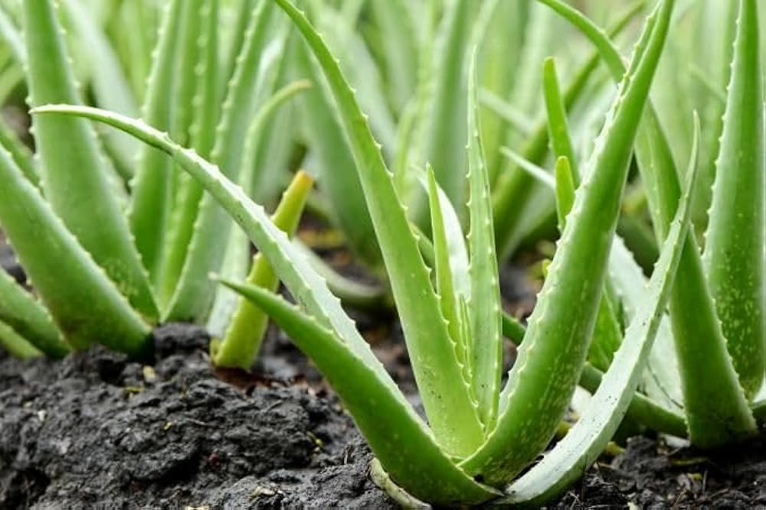
ALOE VERA

Slide 2

Common name : Indian Aloe , Ghrit Kumari
Scientific name : Aloe barbadensis
Family : Asphodelaceae (Liliaceae)
Habit: Aloe vera grows as a succulent with a basal rosette in clumps or spreading via stolons. Older specimens will produce stems with rosettes at the ends. Found in many parts of Africa, Asia, Europe and America.
Distribution : It grows mainly in dry regions of Africa, Asia, Europe and America. In India, it is found is Rajasthan, Andra Pradesh, Gujarat, Maharashtra and Tamil Nadu.

Slide 3
Description:
Height of plant: Aloe vera is a stemless or very short-stemmed plant growing to 60–100 centimetres (24–39 inches) tall, spreading by offsets.
Leaves: The leaves are grey to green and sometimes have white spots on their surfaces. They have sharp, pinkish spines along their edges and are the source of the colorless gel found in many commercial and medicinal products
Flower: Most aloes have a rosette of large, fleshy leaves. Their flowers come in a variety of colors, ranging from white, yellow, orange, red and even pink.
Fruit: The plant has triangular, fleshy leaves with serrated edges, yellow tubular flowers and fruits that contain numerous seeds.
Seeds: Aloe plants must be four or more years old before they produce reliable seed. The exact time depends upon the species and some plants don't mature for up to a decade. the plant is flowering, it is

Slide 4
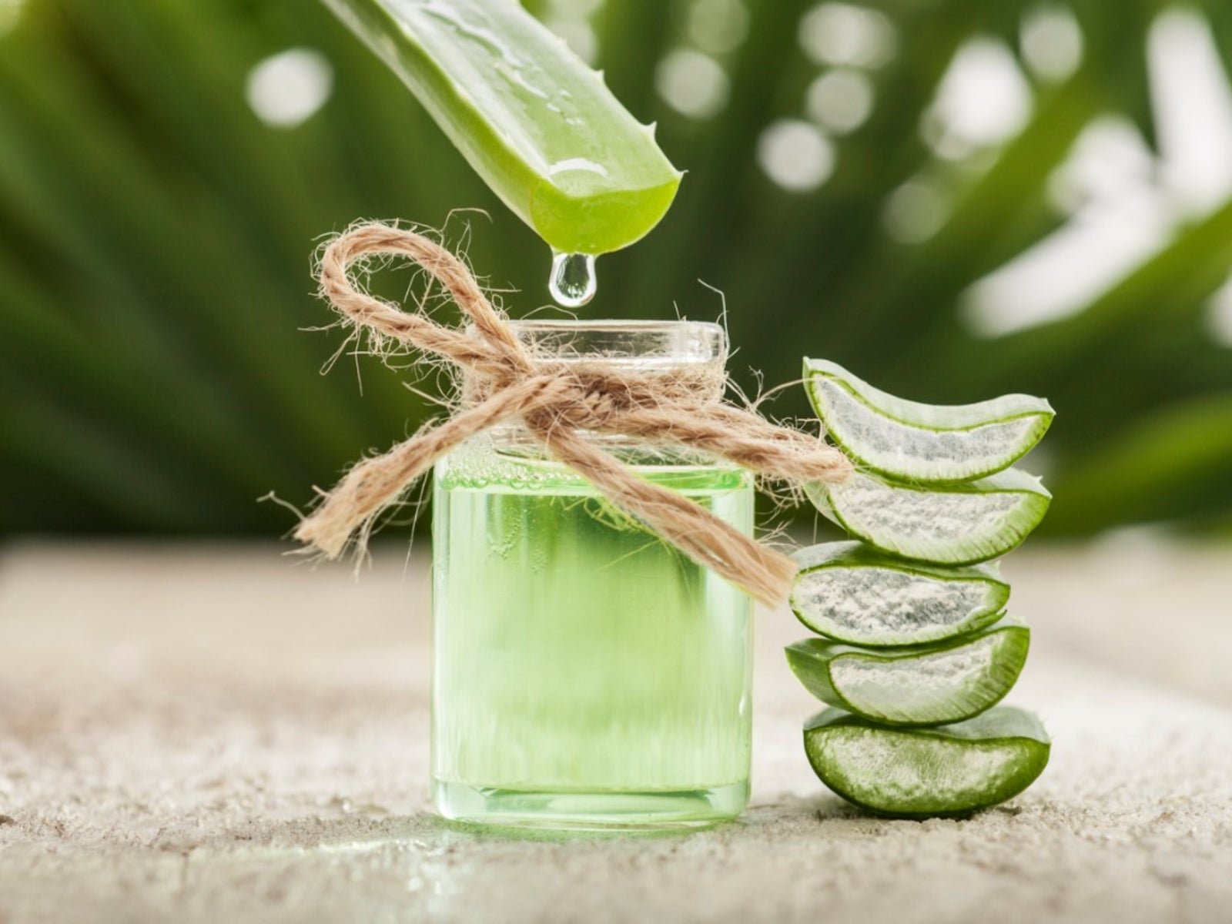
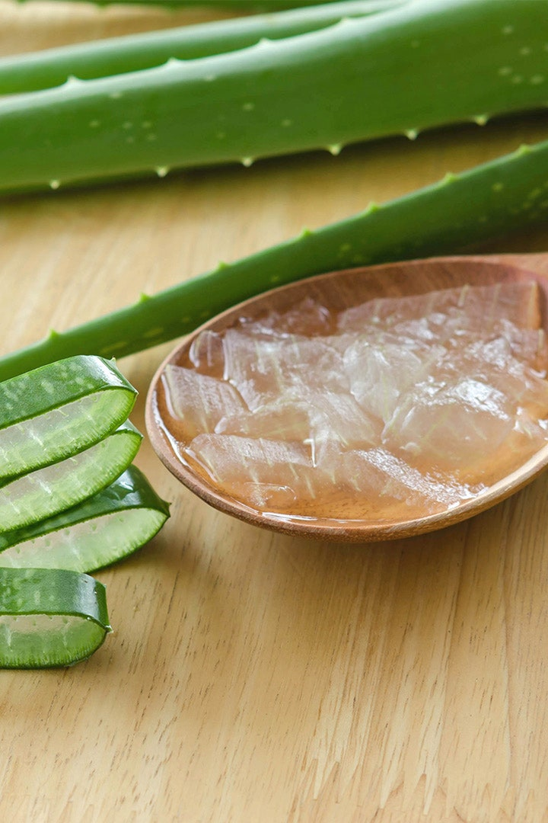
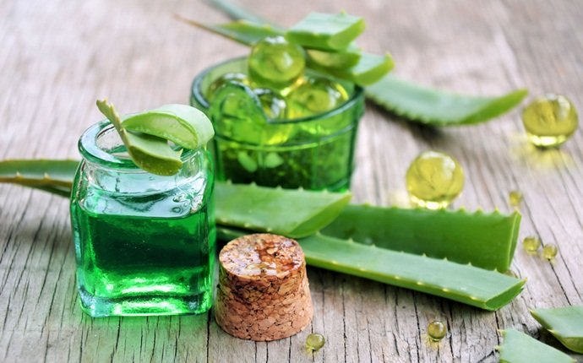
USES

Slide 5
USES :
Aloe Vera Gel: It is useful in the treatment of inflammatory skin conditions, such as ultraviolet-induced erythema. Aloe juice or aloe latex, a yellow, bitter liquid derived from the skin of the aloe leaf, is a powerful laxative.
Aloe juice or Aloe Latex: A yellow, bitter liquid derived from the skin of the aloe leaf, is a powerful laxative.
Aloe vera has many active ingredients and minerals that can help strengthen your hair. It has fatty acids and amino acids and is rich in vitamins A, B12, C, and E. These play a part in healthy hair follicles.
Fruit: The plant has triangular, fleshy leaves with serrated edges, yellow tubular flowers and fruits that contain numerous seeds.

